Slide 1


Kotter’s 8-Step Change Model
Implementing the change powerfully and successfully
Divyanshu Shrivastava
Ekta Singh Parmar
Gajendra Rajoriya
Hariom kumar

Slide 2
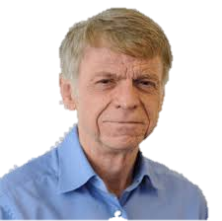
John Kotter
“A professor at Harvard Business School and world renowned change expert, Kotter introduced his eight-step change process in his 1995 book, “Leading Change.” We look at his eight step for leading change.”

Slide 3
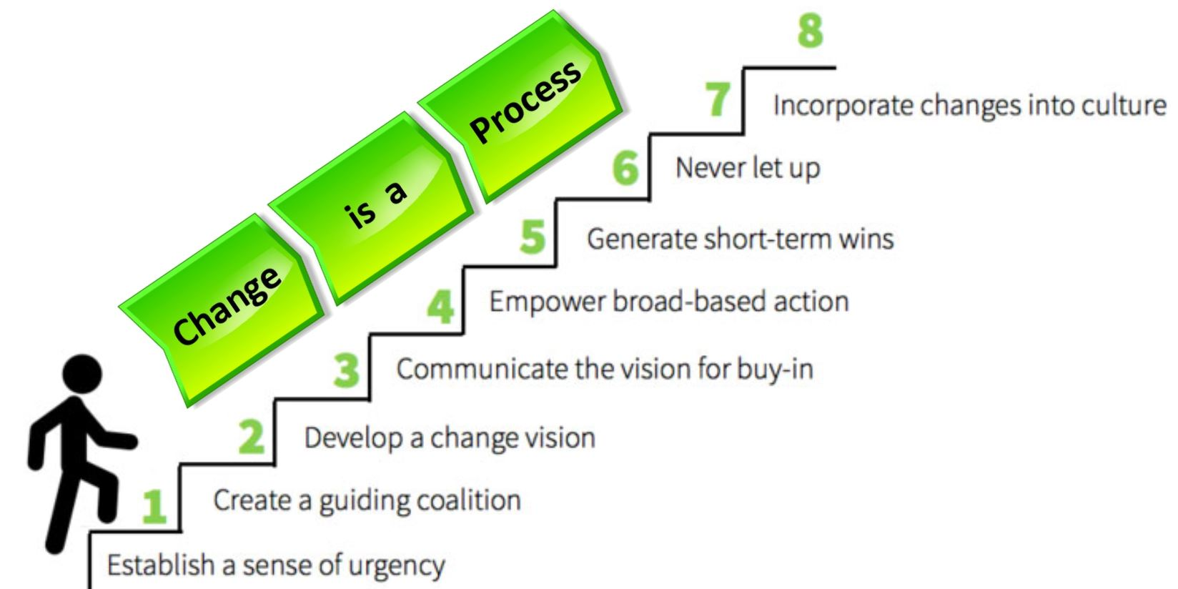

Slide 4
Step - 1
Establish a Sense of Urgency

Slide 5
Establish a Sense of Urgency
“For a change to happen, it helps if the whole organization really wants it. Develop a sense of urgency around the need for change. This may help you spark the initial motivation to get things moving.”
Change comes about because there is some underlying crisis: customers are unhappy, costs are rising, budgets are cut and so on.”

Slide 6
What we’ll do?
Identify Potential threats, and develop scenarios showing what could happen in the future.
Honest facts and dramatic evidence — customer and stakeholder testimonies — show that change is necessary.

Slide 7
Step - 2
Building the Guiding Team

Slide 8
Building the Guiding Team
Creating a sense of urgency helps to bring the right people together. And getting the right people in place is about getting the right team, commitment and trust to do the job. This is what step 2 is about.

Slide 9
What we’ll do?
Identify true leader’s in your organization.
Check your team for weak areas, and ensure that you have a good mix of people from different departments and different level within your organization.

Slide 10
Step - 3
GETTING the RIGHT VISION

Slide 11
Getting the Right Vision
What is our vision for the future? What change is needed? What do we need to do to realize our vision? Good answers to such questions will help the organization to make the future they want more probable.
Creating a vision that can be conveyed in a matter of minutes is going to move people into action much more effectively than detailed analyses ever will.

Slide 12
What we’ll do?
Determine the values that are central to the change.
Develop a short summary (two or three sentences) that captures what you see as the future of your organization.
Create a strategy to execute that vision.

Slide 13
Step - 4
Communicate for buy-in

Slide 14
Communicate for Buy-In
Transformational change projects tend to generate lots of information. Unfortunately the message about organizational change is often lost and people fail to see why the change is needed.
They don’t buy into the idea and start resisting our efforts; we create the wrong emotional response.

Slide 15
What we’ll do?
Talk often about your change vision.
Openly and honestly address people’s concerns and anxieties.
Apply your vision to all aspects of operations from training to performance reviews.

Slide 16
Step - 5
Empower action

Slide 17
Empower Action
Or rather remove barriers! One of the biggest barriers to change is the dis-empowering manager. People often get the message about change and want to do something about it.

Slide 18
What we’ll do?
Identify or Hire or Change leaders whose main roles are to deliver the change.
Recognize and reward people for making changes happen.
Identify the people who resisting change and help them see what’s needed.

Slide 19
Step - 6
Create short-term wins

Slide 20
Create Short-term Wins
Large scale organizational change needs momentum, a sense of achievement, and optimism. Therefore, it is essential that results are achieved quickly.
Short-term wins serve four important purposes:
Provide us with feedback about the validity of our vision and strategies.
Give those working hard to achieve the vision recognition and encouragement.
Build faith in the change project — attracting those who are not actively involved.

Slide 21
What we’ll do?
Look for sure fire project that you can implement without help from any critics of the change.
Reward people who help you meet the targets.
Don’t choose early targets that are expensive. You have to justify the investment in each project.

Slide 22
Step - 7
Implementing and Sustaining Change

Slide 23
Implementing and Sustaining Change
Many changes projects fail because victory is declared too early. Quick wining are only the beginning of what needs to be done to achieve long term change.
Each success provides an opportunity to build on what went right and identify what can you remove.
The idea is to continue with wave after wave of change and not to stop until the vision is a reality.

Slide 24
What we’ll do?
After every win, analyze what went right and what needs to be improving.
Set goals on continuous building on the momentum you’ve achieved.
Keep idea fresh by bringing in new change agents and leaders for your change coalition.

Slide 25
Step - 8
Incorporate changes into the culture

Slide 26
Incorporate changes into the culture
Your corporate culture often determined what gets done, so the values behind your vision must show in day-to day work.
Make continuous efforts to ensure that the changes is seen in every aspect of your organization. This will help give that change a solid place in your organization culture.

Slide 27
What we’ll do?
Talk about progress every chance you get. Tell success stories about the change process, and repeat other stories that you hear.
Create plans to replace key leaders of change as they move on. This will help ensure that their legacy is not lost or forgotten.

Slide 28
conclusion

Slide 29
They recommend a people-driven approach that helps people to see the reason for change. They argue that people change when they are shown the truth because this influences their feelings.
See Compelling and eye-catching situations are created to help show people what the problems are and how to resolve them.
Feel – Visualizing ideas evokes a powerful emotional response that motivates people into action.
Change – The new feelings change or reinforce behaviors that make people work harder to make a good vision reality. The change is more immediate but must be reinforced to keep up the momentum.

Slide 30
Thankyou
Divyanshu Shrivastava – 187909
Ekta Singh Parmar – 187910
Gajendra Rajoriya – 187911
Hariom kumar - 187912

